Slide 1
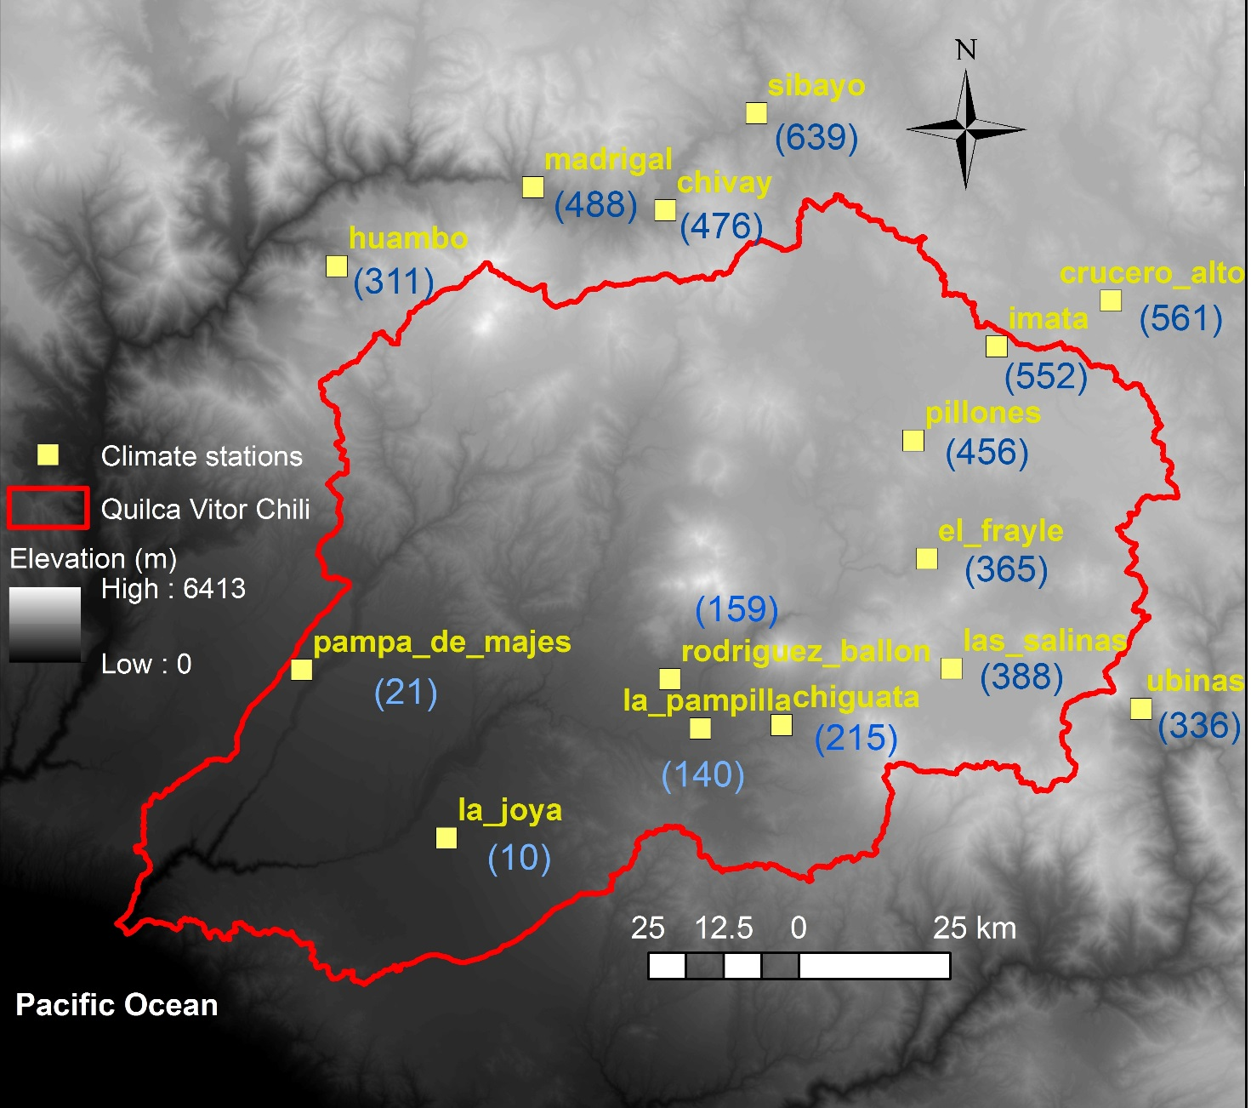
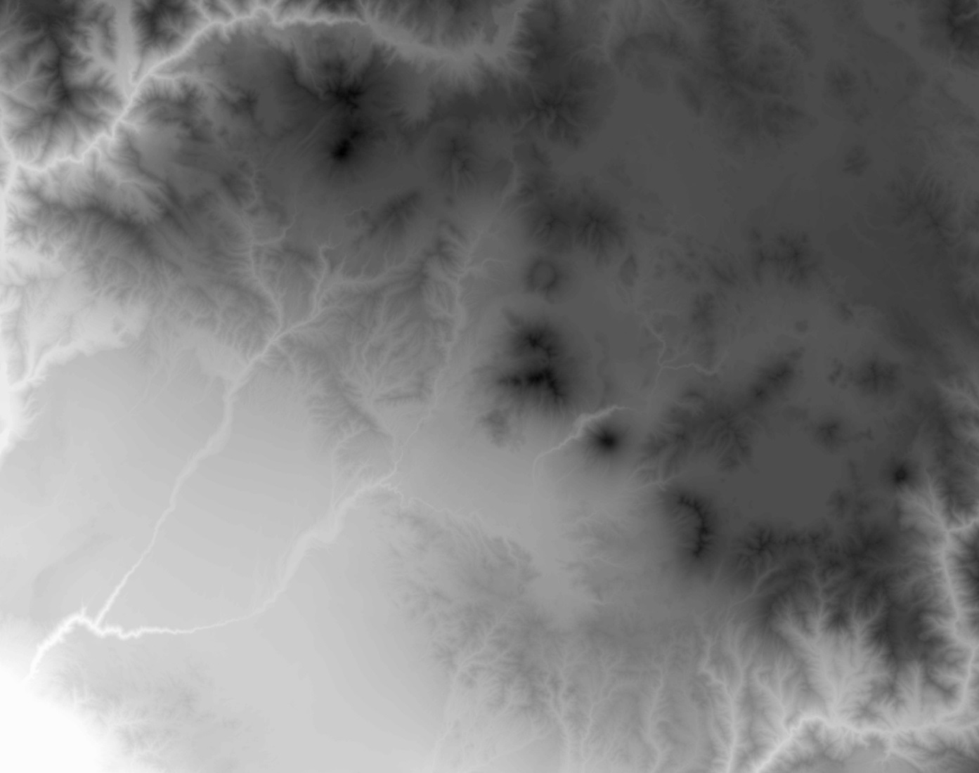
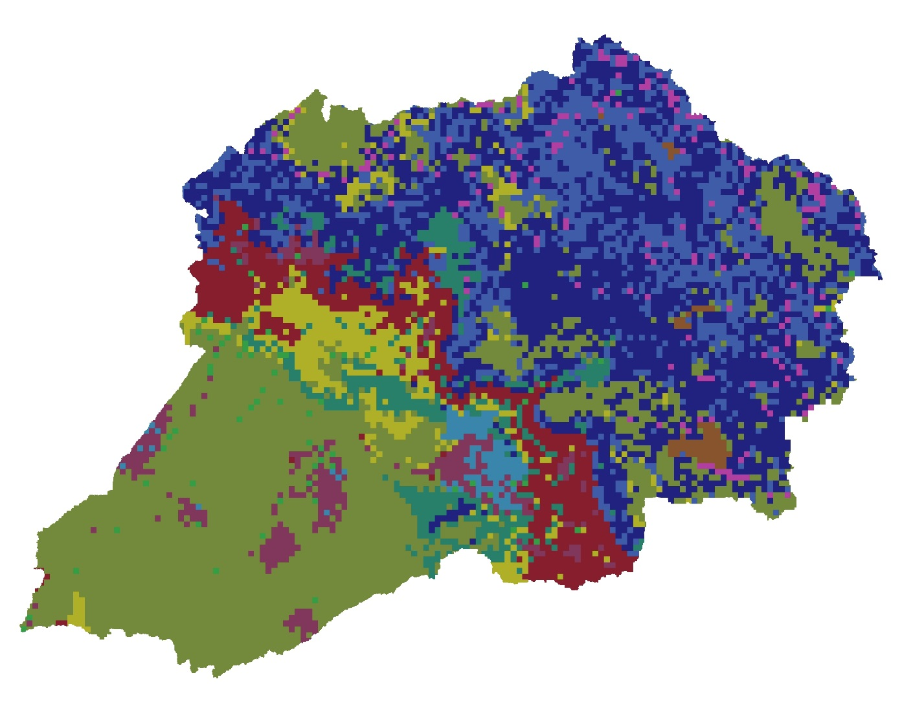
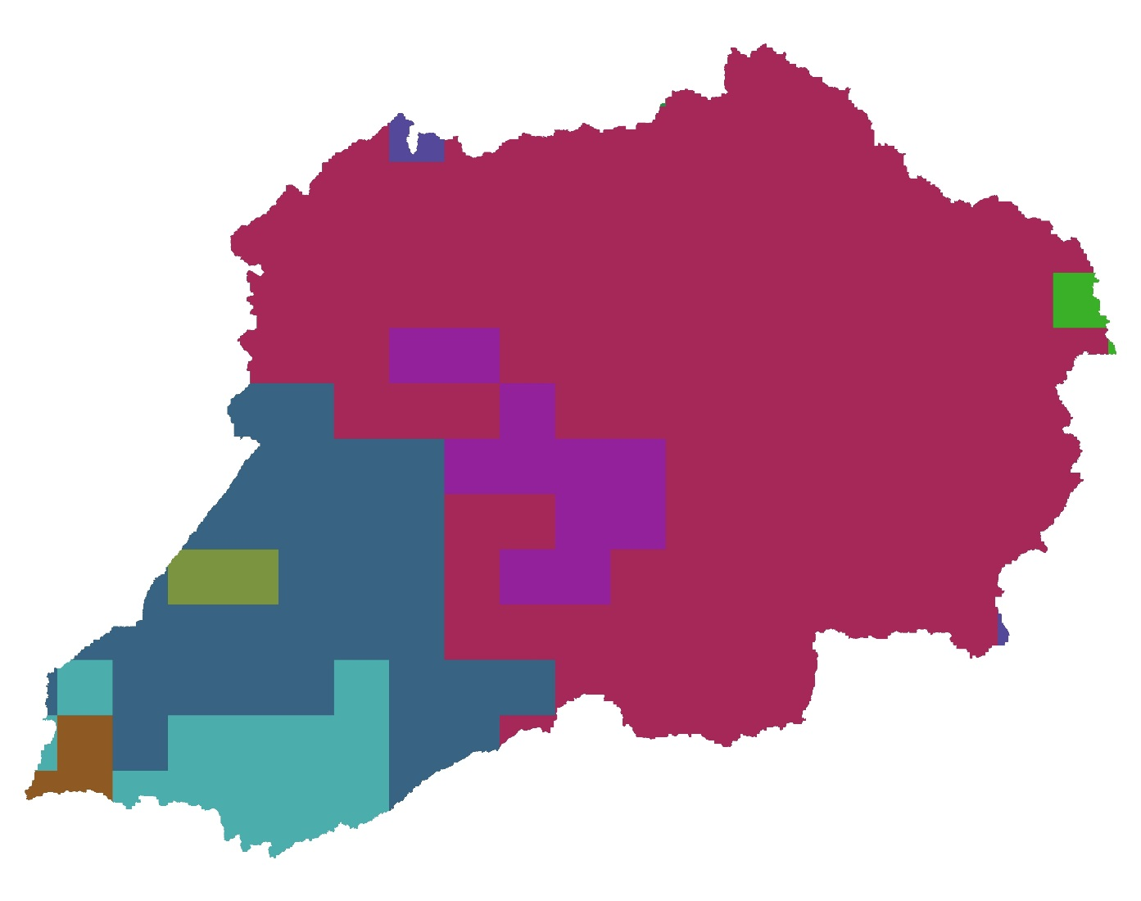
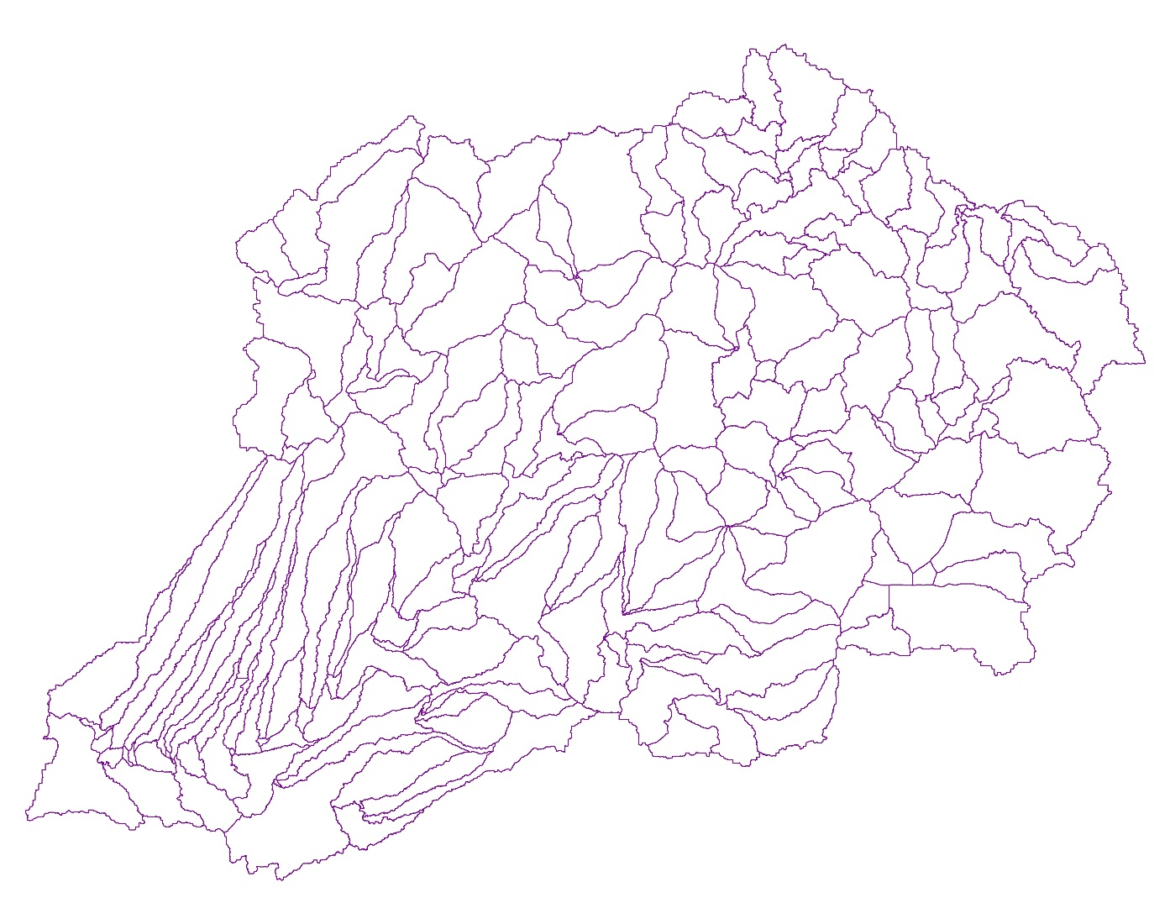
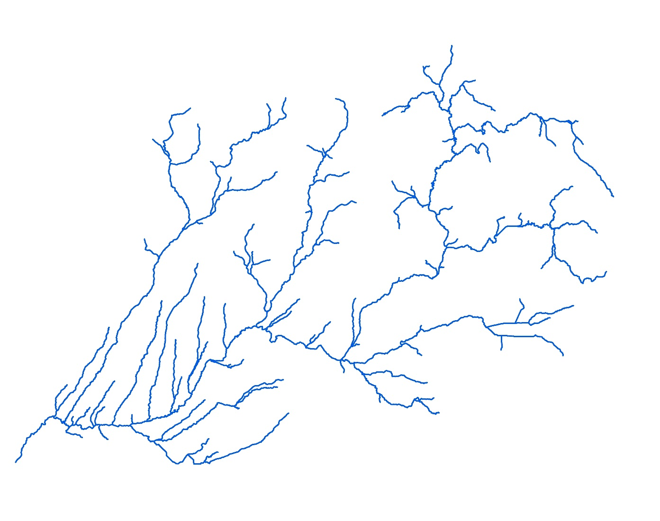
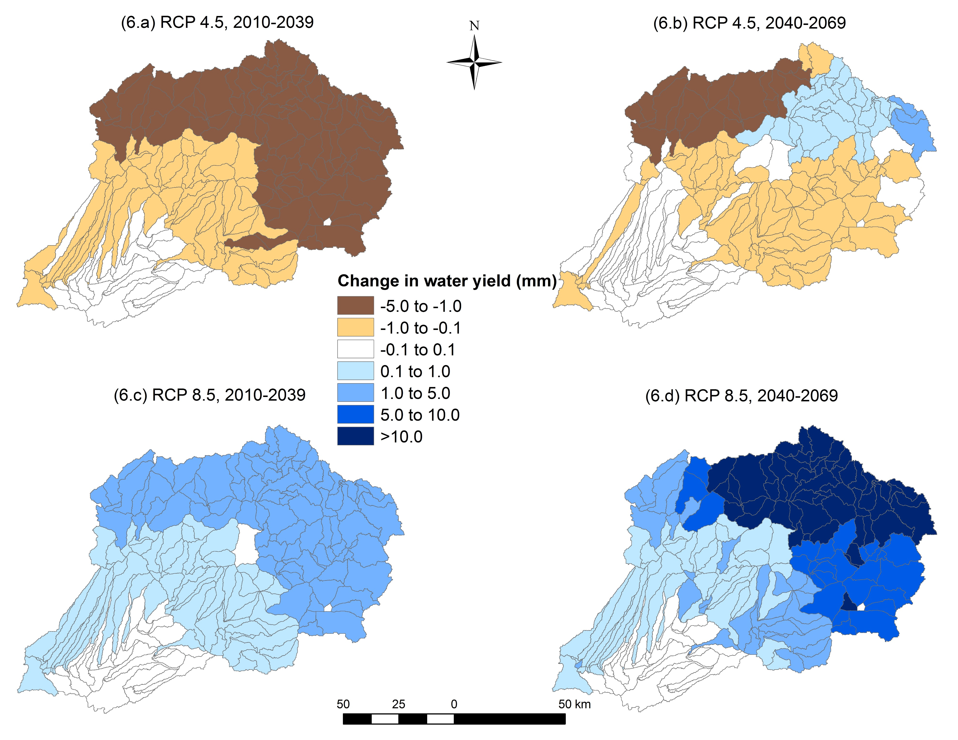
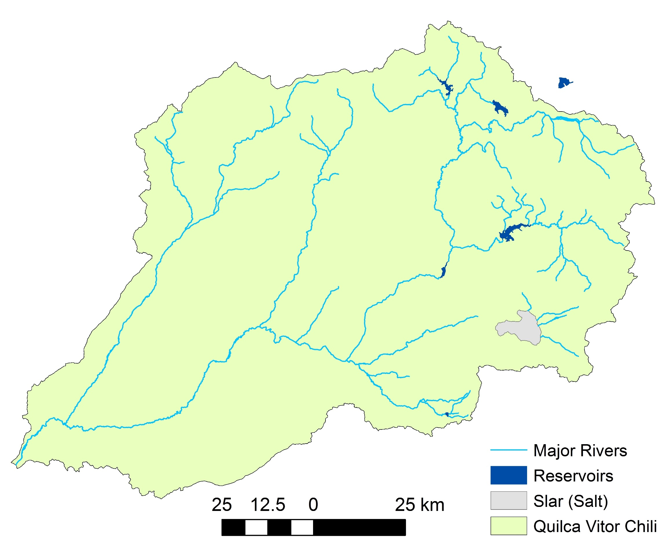
Poster #EP53F-1960
Assessment of climate change impacts on semi-arid watersheds in Peru
Fariborz Daneshvar¹*, Indrajeet Chaubey¹, Laura Bowling², Keith Cherkauer¹, Andre Moraes¹, Jose Herrera³
¹ Department of Agricultural and Biological Engineering, Purdue University, West Lafayette, IN, United States
² Department of Agronomy, Purdue University, West Lafayette, IN, United States
³ School of Computer Science, Universidad Nacional de San Agustín, Arequipa, Peru
* Email: fdaneshv@purdue.edu
MOTIVATION
HYDROLOGIC MODELING
Current Condition
Low seasonal precipitation and high demand for water use
High spatial variation in precipitation (Figure 1)
Need for water regulation and diversion to mitigate impact of future climate variations
Soil and Water Assessment Tool (SWAT)
Physically based, semi-distributed watershed/water quality model
SWAT Inputs layers:
(3.a) Topography (12.5 m)
(3.b) Land cover (1:600,000)
(3.c) Soil (10 km)
Figure 5. Daily average of surface runoff (mm) and water yield (mm) at sub-watershed level for current condition (2009-2017)
(3.d) Sub-watersheds (205)
(3.e) Rivers (205)
Future Scenarios
Figure 1. Average annual precipitation (mm) in the region (2008-2017)
Figure 3. SWAT input layers
OBJECTIVES
SWAT Inputs Databases:
1) Daily climate (precipitation and temperature) for 15 stations
2) Point source discharges (2 points) and withdrawal (1 point)
3) Reservoirs daily release rates
Develop hydrological model to simulate water cycle
Evaluate hydrologic response to climate change
STUDY AREA
CLIMATE SECENARIOS
Quilca-Vitor-Chili River Basin in Arequipa in Peru
Area: 13,549 km²
Major City: Arequipa (population of over 850,000)
Four reservoirs for water regulation
Two water diversions from Camana River Basin
One water withdrawal for irrigation project
NASA Earth Exchange Global Daily Downscaled Projections (NEX-GDDP)
General Circulation Model (GCM) runs conducted under the Coupled Model Intercomparison Project Phase 5 (CMIP5)
Resolution: 0.25 degrees (-25 km * 25 km)
Three climate models: 1) CNRM-CM5, 2) MPI-ESM-MR, 3) MRI-CGCM3
Two Representative Concentration Pathways (RCPs): 1) 4.5, 2) 8.5
Two periods of simulations: 1) Near future (2010-2039), 2 Far future (2040-2069)
water diversion from Camana River Basin
water diversion from Camana River Basin
Figure 6. Ensemble average of daily water yield (mm) at sub-watershed level
water withdrawal for irrigation project
RESULTS
CONCLUSIONS
Charchani station
Hydrologic Model Performance
Slight increase in surface runoff and water yield are predicted in high attitude headwaters, especially for RCP 8.5 in far future (2040-2069)
All models predicted low water supply in low altitude catchments
Incorporation of water diversions and withdrawals into future simulations will provide more accurate picture of water availability and will be subject of future research
Arequipa city
SWAT model calibrated for 2009-2013
Calibration point: Charchani station
Model performance:
NSE: 0.53
PBIAS: -3.79 %
R²: 0.58
Figure 2. Major rivers, water bodies, and water regulations in Quilca-Vitor-Chili River Basin
Figure 4. SWAT model calibration
Funding for this work provided by the Arequipa Nexus Institute for Food, Energy, Water and the Environment through the Universidad Nacional de San Agustín, Arequipa Peru

